Slide 1
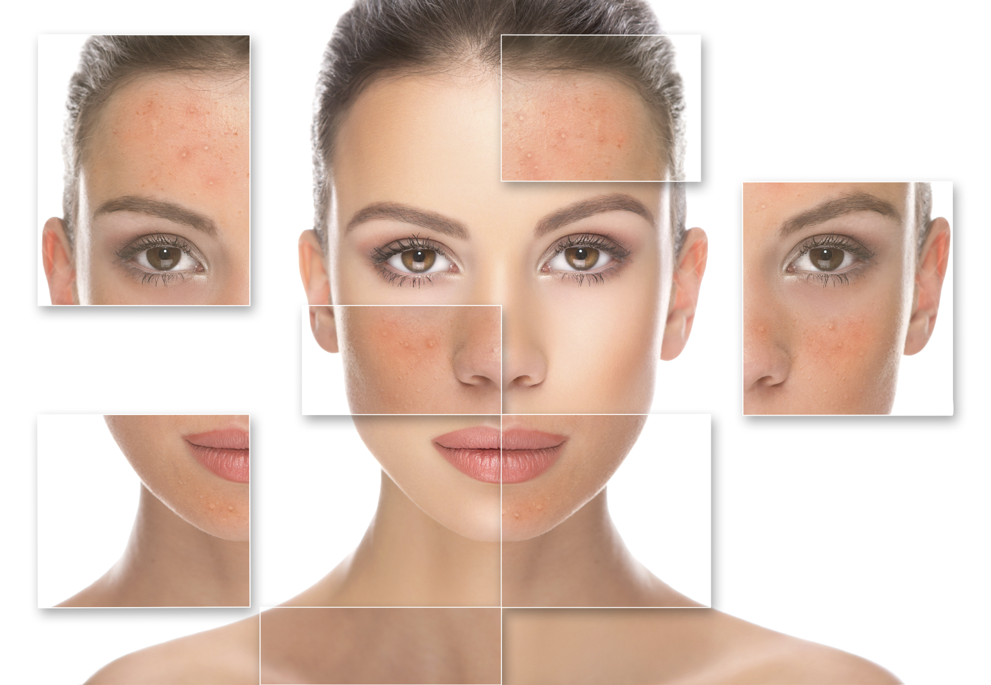
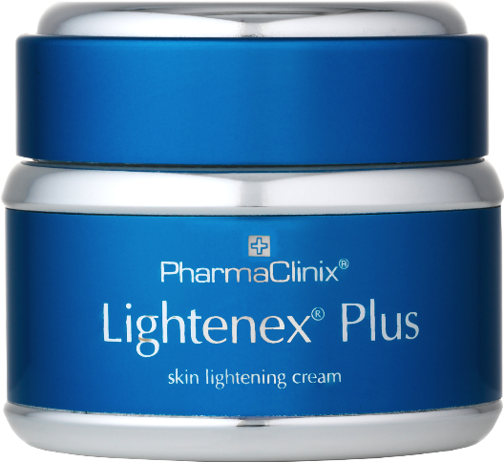
Lightenex® Plus

Slide 2
ACTIVE INGREDIENTS
Azelaic Acid 5%
Licorice Extract 5%
(Glabridin, Glabrin & Isoliquertin)
Phytic Acid 5%
Nobeltine & Hespridin 4%
(Citrus unshiu extr)
Xanthumol 3% (Humulus Lupulus ext)
Salicylic acid 2%
Mulberry extract 3% (Arbutin) (Glucopyranosides)
Arbutin 2% & Magnesium
Ascorbyl Phosphate
Total percentage of Depigmenters = 34%
Diacetyl Boldine & Titanium Di-oxide 3%
Octadecene-Dioic Acid 2%

Slide 3
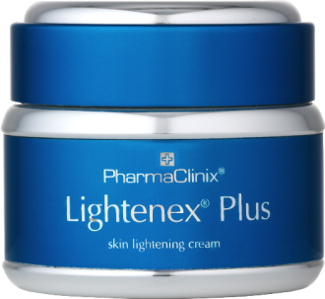
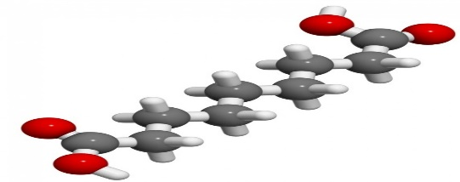
Azelaic Acid 5%
Powerful Inhibitor of enzyme Thioredoxin Reductase.
This enzyme adds electrons to Thioredoxin which can then activate Tyrosinase & also help make DNA.
This accounts for why Azelaic acid only work on Hyperactive Melanocytes where DNA synthesis is fast.
Ref-Arch Dermatol Res1990;282(3).168-171.A possible mechanism of action for Azelaic Acid in the human Epidermis.Schallenter KU et al,Dept of Dermatology,University of Hamburg,Germany.

Slide 4
Azelaic Acid 5%
Azelaic acid has an anti-proliferative & Cytotoxic effect on Melanocytes.
Proven as effective as Hydroquinone in Melasma.
Gentle exfoliant -removes melani n loaded epidermal cells gently without irritation
REF-DRUGS 1991 May;41(5):780-798.Azelaic acid.AReview og its Pharmacological properties&therapeutic efficiency in Acne&Hyper-pigmentary skin disorders..Fitton GA.Drug information service,Auckland,Australia.

Slide 5
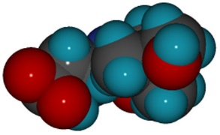
Phytic Acid 5%
Phytic acid Chelates Copper & Iron in skin(makes them unavailable)
Copper is essential part of the enzyme tyrosinase which makes melanin.
Gentle exfoliant
Iron catalyses free Radilcle formation & subsiquent Oxidative damage.
REF-Will Phytic acid replace Hydroquinone.Romulo Mene MD.Plastic Surgeon.Rio De Janiero,Brazil.Third Congress of National Estetic Medicine.Milan,Italy 12 Oct 2001

Slide 6
Phytic Acid 5%
Phytic acid prevents Iron driven hydroxyl radicle generation &prevents Lipid Peroxidation.
Is a depigmenting agent,prevents Calcinosis cutis (calcium leaching) & premature ageing along with skin cancer.
Very well absorbed into skin
REF-Journa.l Biol.Chem.1987 Aug 25;262(24):11647-50.Phytic acid .A Natural Anti-oxidant.Graf E,Empson KL et al
REF-Front Biosc 2005 Jan 1;10:799-802.Absorption of Myo-Inositol Hexakisphosphate through the skin;study of the matrix effects.Mechanism of Phytate topical absorption

Slide 7
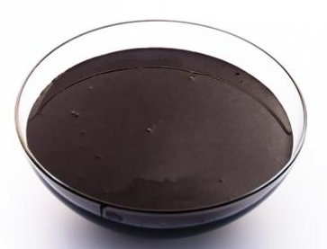
Licorice Extract 5%
(Glabridin,Glabrin,Isoliquertin)
Glabridin powerfully inhibits both tyrosinase isoenzymes T1 & T3.
Prevents Erythema & hyperpigmentation at 0.5% in skin from UV-light.
Anti-inflammatory action by inhibiting Super-oxide anion production % Cyclo-oxygenase activity.
Inhibition of Licorice extract on Tyrosinase is higher than expected from Glabridin alone.
REF-Pigment Cell Research 1998 Dec;11(6):355-61.The Inhibitory effect of Glabridin from licorice extract on Melanogenesis & Inflammation.

Slide 8
Licorice Extract 5%
(Glabridin,Glabrin,Isoliquertin)
Glabrene&Isoliquertin (Chalcone) present in Licorice extract in Licorice extract inhibit Tyrosinase strongly.
A split face controlled study in Egypt on 20 female Melasma patients using Isoliquertin cream over 10 weeks gave a 70% response & only 20%in Placebo patients.
REF-Journal of Agricul Food Chem,2003,51(5),pp1201-1207.Ohad Nerya et al.Laboratory of natural compunds for Medicinal use,Migal,Galilea,Technological centre,PO BOX 831,Kiryat Shmona 11016.Israel.
REF-Int J Dermatology 2000 Apr;39(4):299-301.Topical Liquertin improves Melasma.Amer M,Metwalli M,Dept of Dermatol,Zagazig,University of Egypt.

Slide 9
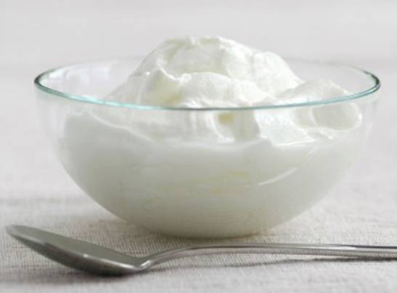
Melaslow
(Citrus unshiu ext)-Nobelitine Hesperidin
In Vitro :
1%Melaslow reduces Melanin by 32%
3%Melaslow reduces melanin by 50%
Twice daily 5% Melaslow on 20 volunteers for age spots showed 28% decrease in 6 weeks & 71 % patient satisfaction
19 patient study on face Lightening showed 27%reduction in 6 weeks as shown by colorimetric.
REF-SEDERMA DISCLOSURES.

Slide 10
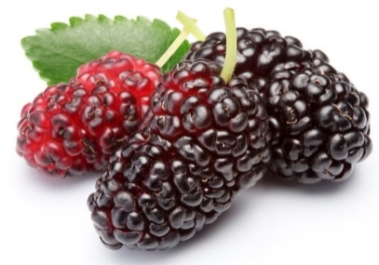
Mulberry Extract 4%
(GLUCOPYRANOSIDES)(HYDROQUINONE ANOLOGUES)
As well as two hydroquinone analogues,it contains two new compounds
Chalcones are 757 & 328 times more potent than Kojic acid in Tyrosinase inhibition.
REF-Anal Chem Acta.2012 Mar16;719:87-95.An Ultra-filtration for screening&charcracterising Tyrosinase inhibitors from Mulberry leaves.

Slide 11
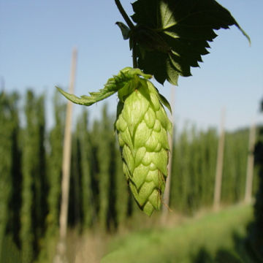
Xanthumol 3%
(Humulus Lupulus Extract) (SEDERMA-WONDERLIGHT)
Acts directly on Keratinocytes to inhibit the release of the Cytokine GM-CSF which signals skin damage to the Melanocyte
Acts directly on Melanocyte to inhibit Micro-opthalmia associated Transcription Factor(MITF) which is the Master Regulator Transcription facor of Melanogenesis.
Therefore inhibits the synthesis of mRNA at transcription level
REF-Exp Mol Med 2008 June 30;40(3)313-319.Korean Society of Molecular Biochem&Mol Biol.Effect of Xanthumol on Melanogenesis.Dept of Dermatology,Medical School&Inst for Med Sciences,Choubuk National University,JEOUJU 561-756 Korea.Tel

Slide 12
Xanthumol 3%
(Humulus Lupulus Extract) (SEDERMA-WONDERLIGHT)
MITF inhibition causes reduced Tyrosinase,Tyrosinase related protein1&2(TRP1&2).
In Melanocytes -inhibits proliferation -inhibition differentiation, Melanin synthesis & dendritogenesis
Quasi drug additive approved for Japan
Direct inhibition of Melanin synthesis comparable to Kojic Acid.
REF-SEDERMA DOCUMENT DISCLOSURES

Slide 13
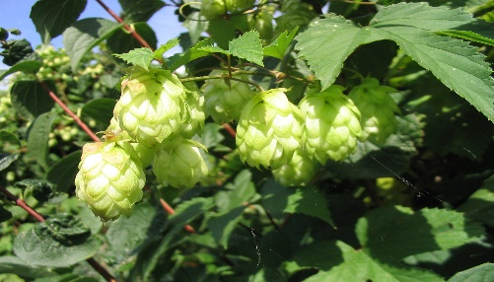
Xanthumol Sederma-Wonderlight
Treatment of freckles & Lentiges in 25 Asian women Phototypes 3 or 4 mean age 34.1 yrs. Twice daily application of 3%wonderlight for 56 days resulted in upto 55%improvement in freckles & lentiges by Chromametry.

Slide 14
Artubin & Map
(Melfade)
62 Melasma patient study comparing 2% Hydroquinone with Melfade cream showed no difference in results between the two.
In Vitro 1% inhibits 100% of mushroom Tyrosinase activity
In Vivo on a comparative study it was 80% more effective than Beta Arbutin.
REF-Comparative efficacy of topical hydroquinone &melfade in the treatment of Melasma.Dept of Dermatol,Besat Hospital,Sanandaj,Kurdistan,Iran 2009.

Slide 15
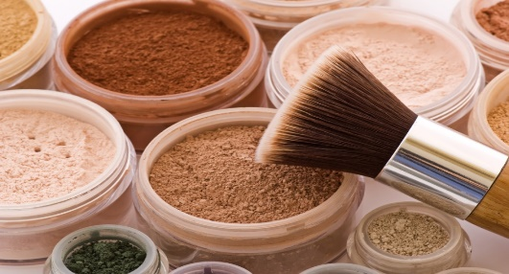
Dioctyl Boldine & Titanium Dioxide 3%
Boldine is a Strong free Radicle scavanger (Anti-oxidant)
Anti-inflammatory action & Anti-pyretic action (lowers body temperature)
Prevents oedema,tissue damage & neutrophil infiltration.
In human back skin it prevents skin redness in response to UV light.
REF-Boldine &its anti-oxidant or health promotion properties. Chem Biol Interact.2006 Jan2006 Jan 5;159(1):1-17.OBrien P etal.Graduate Dept of Pharmaceutical Sciences,Faculty of Pharmacy,University of Toronto,Ontario,Canada.

Slide 16
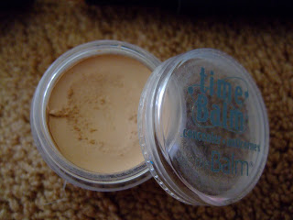
Di-acetyl Boldine
In a 27 Asian women study phototypes 3-4, DAB on average lightens pigmentation by 25% over 8 weeks.
All 100% of tested were satisfied with the lightening effects.
REF-Research Disclosures:Author:Sederma.SAS.France.Research Number 532011.ISSN0374-4353.

Slide 17
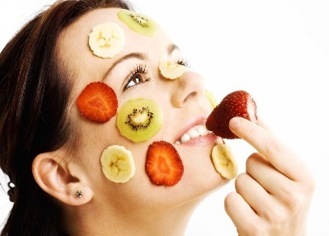
Octadecene Dioc Acid 2%
(Dioic Acid) (Azelaic type di-carboxylic acid)
Prevents Transcription of Melanin synthesising enzyme Tyrosinase.
96 patient open, comparative 12 week study comparing 1% Dioic acid to 2% Hydroquinone showed no difference over 12 weeks
REF-Int J Dermatol.2009 Aug;48(8):893-5.Efficacy of Dioic acid compared with Hydroquinone in Melasma.Tirado-Sanchez A et al

Slide 18
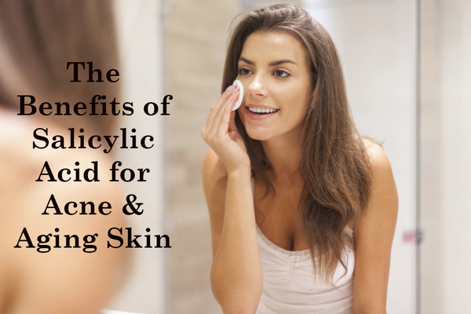
Salicylic Acid 2%
Anti-inflammatory action by irreversible inhibition of Cyclo-oxygenase 1 & 2(COX 1 & 2)
Prevents release of Prostaglandin E that triggers skin inflammation leading to post-inflammatory hyper-pigmentation
At 2% it has no Keratolytic action

Slide 19
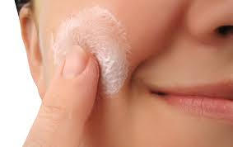
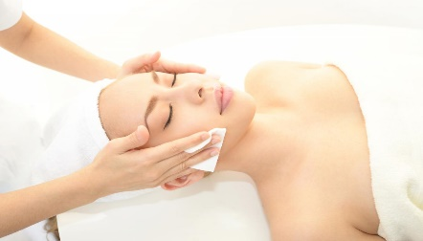
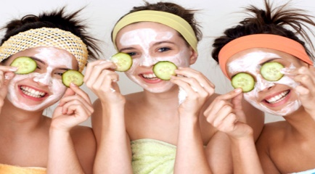
Conclusion For New Formulation
1
Logical choice for treating Epidermal hyper-pigmentation.
2
For maintaining depigmentation after skin peels
3
Perfect Day cream without irritation

