Slide 1
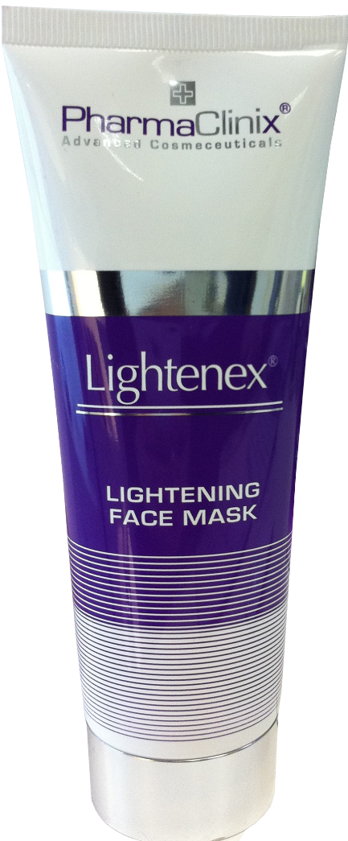
UK’s top selling Professional Skincare
Fast acting
Complex formulations
Clinically proven ingredients
Economical price
PharmaClinix Ltd, Unit 3 Issigonis House, Cowley Road, London, W3 7UN, UK

Slide 2
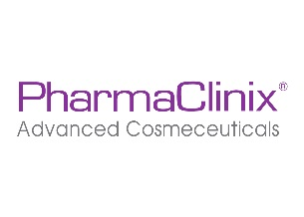
Lightenex® Face Mask
This unique whitening face mask is designed specifically for immediate lightening of the face !

Slide 3
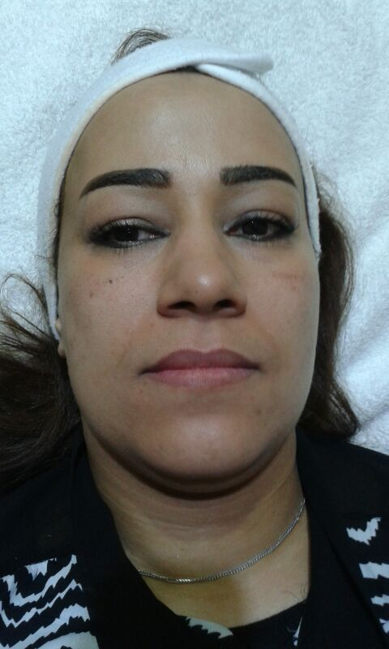
Lightenex® Face Mask
After 1 Facial
Before
After

Slide 4
Lightenex® Face Mask
After 6 Facials
Before
After

Slide 5
UP TO 40%
Lightenex® Face Mask
UP TO 40%
INCREASE in Skin Firmness
Instant glow in 20 minutes
Use after exfoliation, when pores are open
Removes brown pigment (Melanin)
Removes impurities & excess oil
Enhances the skin’s renewal process
Tightens skin

Slide 6
Rapid skin lighteners
Actinidia Chinesis
Citrus Unshui Peel extract (tyramine)
Actostaphylos Uva Ursi extract (arbutin)
Mittracarpus Scaber extract
Niacinamide
Glycyrrhiza Glabra extract
Malva Sylvestris extract
Total percentage of whiteners 20%

Slide 7
Skin Conditioners
Propylene Glycol
Humulus Lupus extract
Hamamelis Virginiana extract
Salvia Officinalis extract
Citrus Medica Limonum peel extract
Caesalpinia Spinosa Oligosaccharides and gum
Panthenol and Calcium Pantothenate
Magnesium, Potassium, Aluminium, Zinc and Manganese chlorides
Malva Sylvestris extract
Persea Gratissima oil
Camelia sinensis extract

Slide 8
Immediate and long-acting moisturizers
Cetearyl alcohol
Cetyl Palmitate
Cetearyl Isononanoate
Glycerin
Propylene Glycol
Equl Setium Arvense extract5
Anti-Microbials

Slide 9
Astringents
Humulus Lupus extract
Hamamelis Virginiana extract
Equisetium Arvense extract
Zinc oxide
Camelia sinensis extract

Slide 10
Anti-Microbials
Rosmarinus Officinalis extract
Salvia Officinalis extract

Slide 11
Direction Of Use
Apply mask to clean, dry skin avoiding eye area.
Leave on for 20 minutes and then rinse with warm water.
Use 2-3 times per week for best results.
Can be used with Lightenex® skin cream range

Slide 12
How its work
Lightenex® Face Mask contains the high concentrations of 7 skin whitening agents, which work together to give you the best skin lightening results! The unique patent pending formula incorporates proven plant extracts, herbs, Antioxidants, stabilized Vitamin C, in Liposomes. The ingredients work together to inhibit the activity of tyrosinase, the key enzyme in the synthesis of melanin & fight against free radicals.

Slide 13
Conclusion
Lightenex® Face Mask Works
www.Lightenex.com

